Slide 1

Arrays Recap
Alright, I want to recap what we've learned so far about arrays, and discuss some of the common errors, that occur using arrays.
COMPLETE JAVA MASTERCLASS
Arrays Recap

Slide 2
Arrays Recap
An array is a data structure that allows us to store multiple values, of the same type, in a single variable.
The default values of numeric array elements are set to zero.
Arrays are zero indexed, so an array with n elements, is indexed from 0 to n - 1, for example, 10 elements would have the index range from 0 through 9.
If we try to access an index that is out of range, Java will give us an ArrayIndexOutOfBoundsException, which indicates that the index is out of range, in other words, out of bounds.
To access array elements, we use square braces. This is also known as the array access operator.
COMPLETE JAVA MASTERCLASS
Arrays Recap

Slide 3
Arrays Recap - Creating a New Array
This array contains the elements from array[0], through to array[4].
It has 5 elements, and an index range, from 0 to 4.
The new operator or keyword, is used to create the array, and initialize the array elements to their default values.
In this example, all the array elements will default to zero, because it is an int array.
For boolean arrays, elements would be initialized to false.
If you use String or other objects, they would be set to null, or a null reference.
COMPLETE JAVA MASTERCLASS
Arrays Recap

Slide 4
Arrays Recap - Creating a new Array
We can also initialize an array inline, using an array initializer block, as we show here.
We define the values for the array, in curly braces, in the order we want them assigned, each value separated by a comma.
This way of initializing array elements, is also known as an anonymous array.
It has 5 elements, and an index range from 0 to 4.
In this example, the array elements are initialized to 5 down to 1.
COMPLETE JAVA MASTERCLASS
Arrays Recap

Slide 5
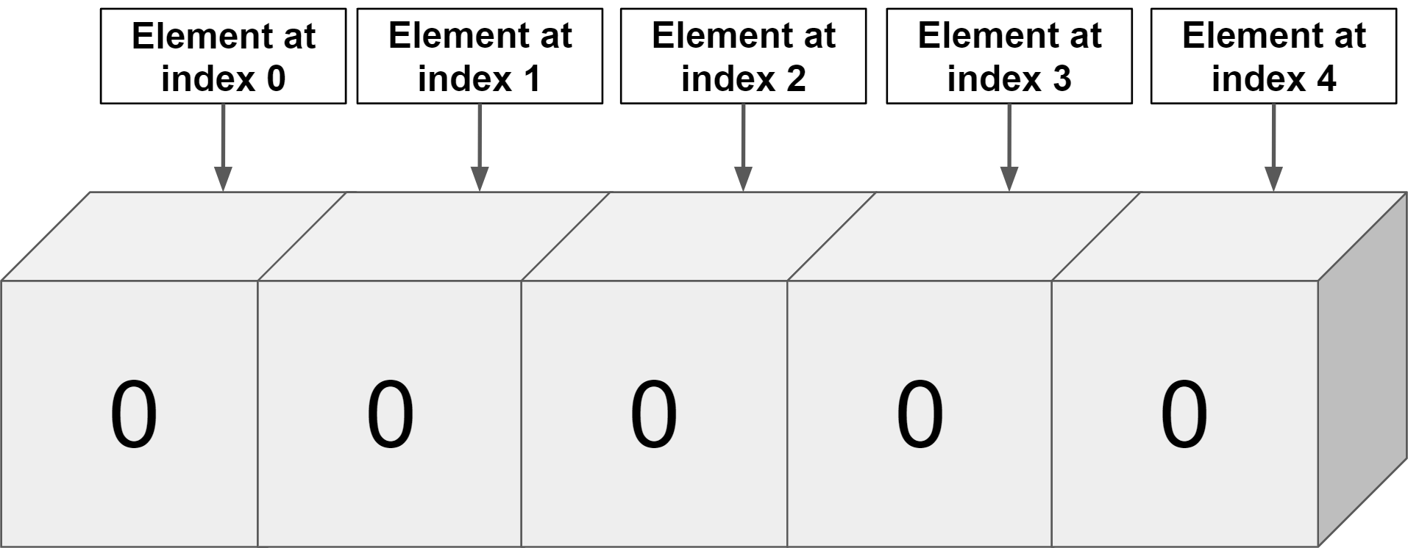
Arrays Recap
COMPLETE JAVA MASTERCLASS
Arrays Recap

Slide 6
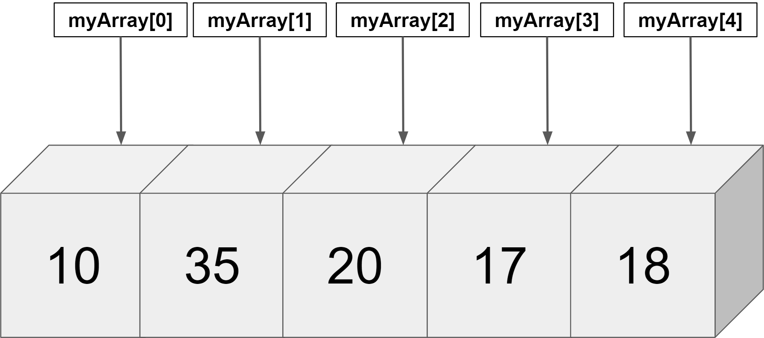
Arrays Recap
COMPLETE JAVA MASTERCLASS
Arrays Recap

Slide 7
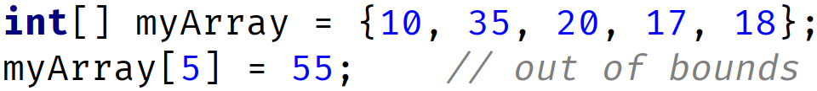
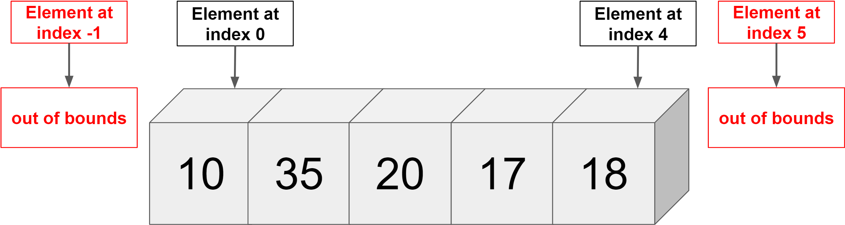
First Common Error
Accessing index out of range will cause error in other words ArrayIndexOutOfBoundsException
We have 5 elements and index range is 0 to 4
COMPLETE JAVA MASTERCLASS
Arrays Recap

Slide 8
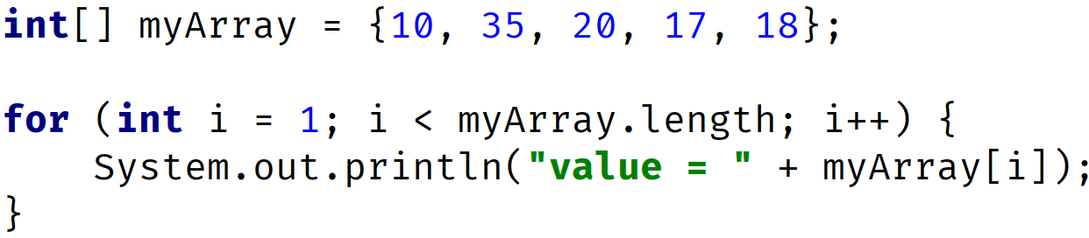
Second Common Error
OUTPUT: value= 35 value= 20 value= 17 value= 18
COMPLETE JAVA MASTERCLASS
Arrays Recap

Slide 9
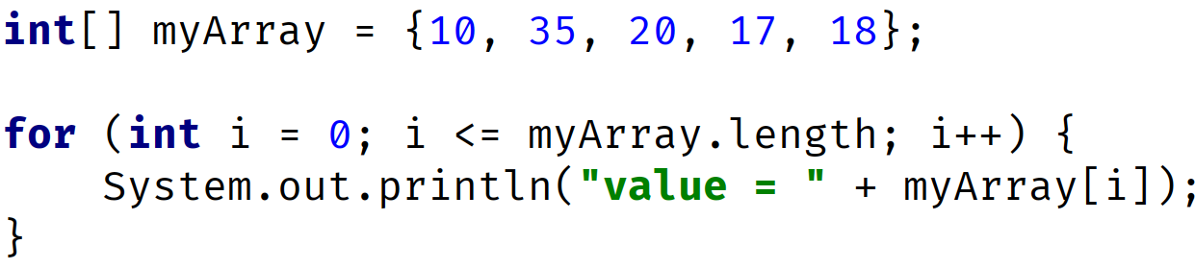
Third Common Error
OUTPUT: value = 10 // printed when i = 0 -> condition 0 <= 5 is true value = 35 // printed when i = 1 -> condition 1 <= 5 is true value = 20 // printed when i = 2 -> condition 2 <= 5 is true value = 17 // printed when i = 3 -> condition 3 <= 5 is true value = 18 // printed when i = 4 -> condition 4 <= 5 is true ArrayIndexOutOfBoundsException when i = 5 since condition 5 <= 5 is true
COMPLETE JAVA MASTERCLASS
Arrays Recap

Slide 10
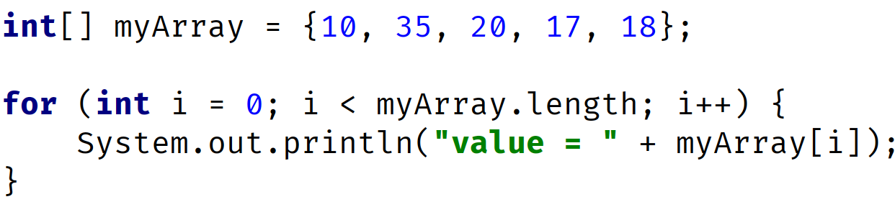
Third Common Error
OUTPUT: value = 10 // printed when i = 0 -> condition 0 <= 5 is true value = 35 // printed when i = 1 -> condition 1 <= 5 is true value = 20 // printed when i = 2 -> condition 2 <= 5 is true value = 17 // printed when i = 3 -> condition 3 <= 5 is true value = 18 // printed when i = 4 -> condition 4 <= 5 is true
COMPLETE JAVA MASTERCLASS
Arrays Recap

Slide 11
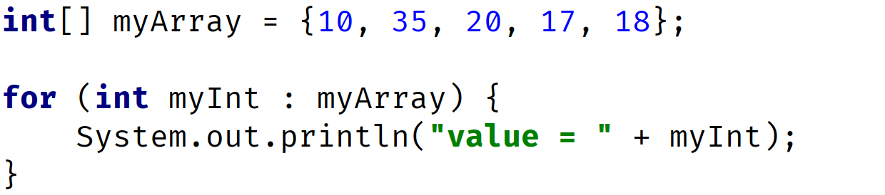
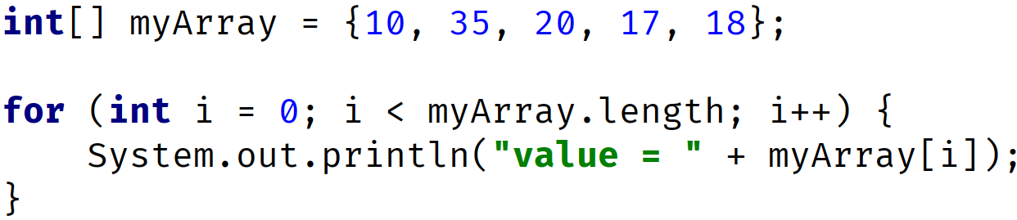
Use Enhanced For Loop to avoid some of these errors
Use the enhanced for loop, if you're looping through elements from first to last, and want to process them one at a time, and you're not setting or assigning values to elements.
Enhanced For Loop (Preferred for this kind of processing)
Traditional For Loop
COMPLETE JAVA MASTERCLASS
Arrays Recap

